Slide 1
PROJECT BIST 5092
Cicily, Bonnya, Eric
MS PHASE III August 2023

Slide 2
SAMPLE SIZE CALCULATION
Study Design
1. Primary Family - Drug X vs. placebo
Sample Size - PASI 75 at Week 12, 210 mg
1. Power: ≥ 0.90
2. Type I Error: α = 0.01, two-sided
3. Testing Method: Parallel
4. Response Rate - Placebo: 10 %
5. Response Rates for Drug X: 30%, 50% and 70%.
6. Randomization ratio (test drug vs placebo): 1:1 and 2:1.

Slide 3
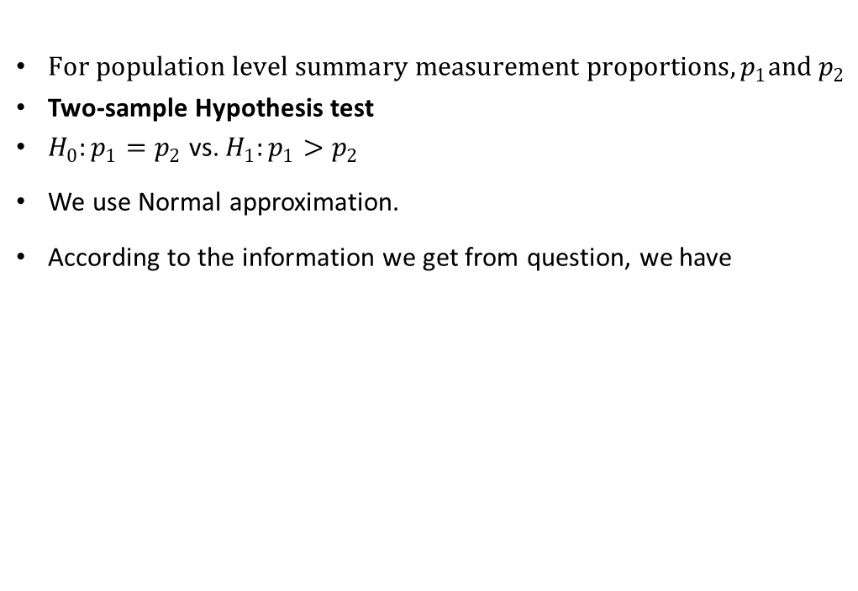
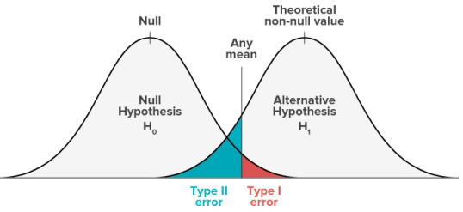
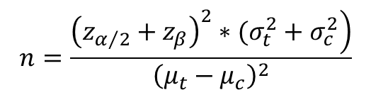
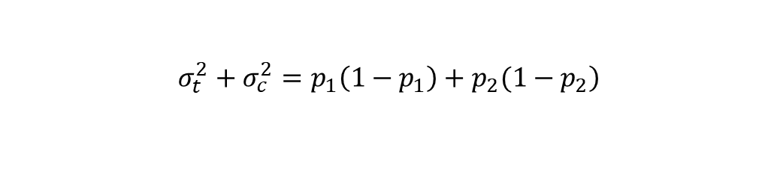
Normal Distribution
SAMPLE SIZE FORMULA
BINARY –TWO ARMS
And we could regard the treatment effect as a Bernoulli distribution, whose variance is p(1-p), so we could get

Slide 4


Randomization Ratio : Test drug : Placebo =1:1
We already know for balanced group, sample size is
Where α is the type I error, β is the type II error, and p_1 is the effect size of drug, p_2 is the placebo.
Pre-specifying
We have
 |  | Response Rate
Randomization 1:1 | 30% | 50% | 70%
Sample size¹ | 233 | 73 | 34

Slide 5
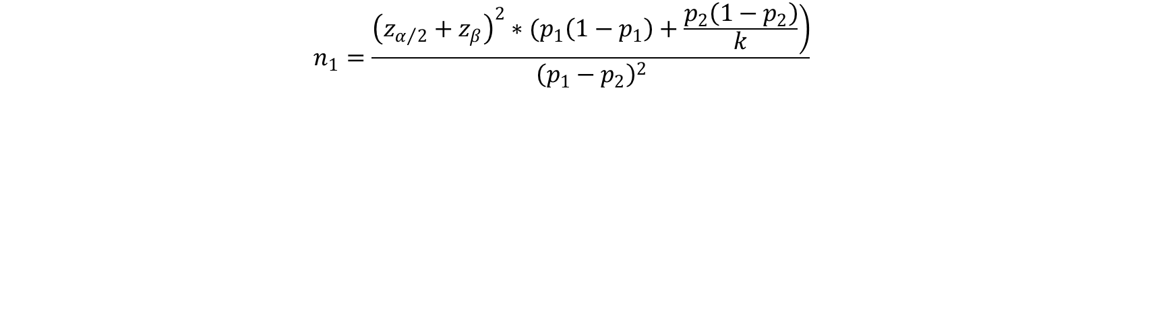

Randomization Ratio : Test drug : Placebo =2:1
We have the sample size formula:
We pre-specify
Then we have
And according to the question, we have
 |  | Response Rate
Randomization 2:1 | 30% | 50% | 70%
Sample size¹ | 271 | 84 | 38

Slide 6
SECTION 2: DATA ANALYSES

Slide 7
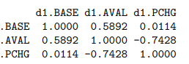
EXPLORATARY ANALYSIS
Correlation between Opening & Closing PASI Scores
“AVAL” PASI scores (closing )are lower than “BASE” scores- so we can expect improvements through treatment.

Slide 8
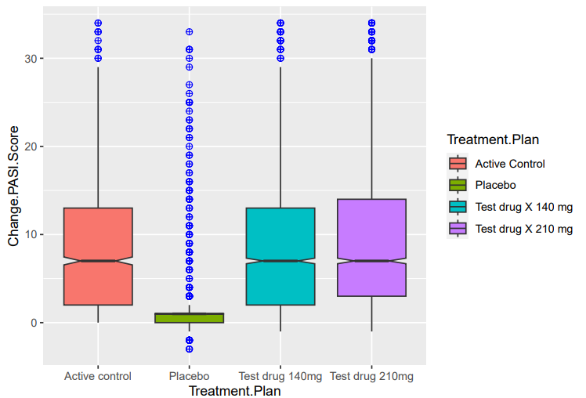
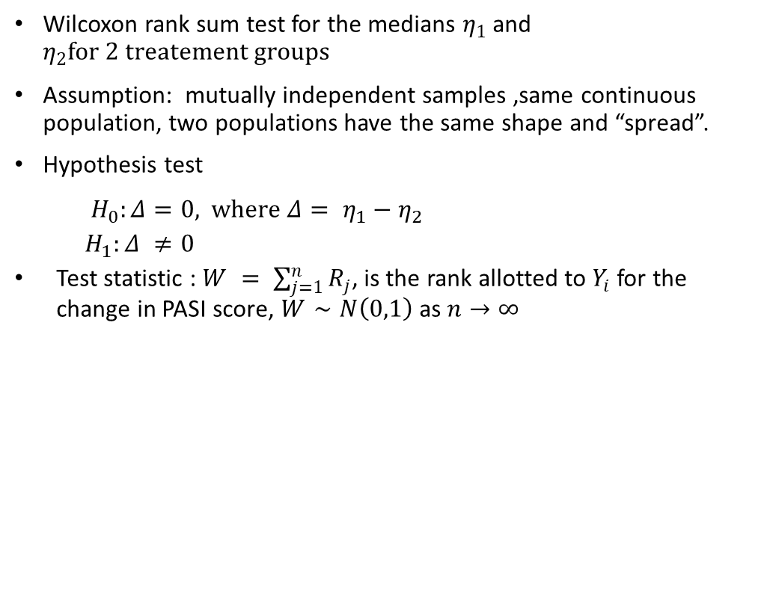
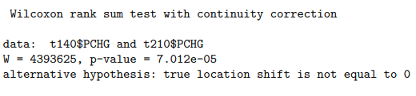
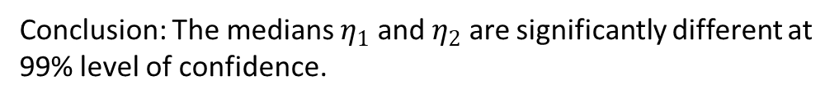
PASI >= 75 vs. Treatment Type
Test drug 140 mg vs. Test drug 210 mg

Slide 9
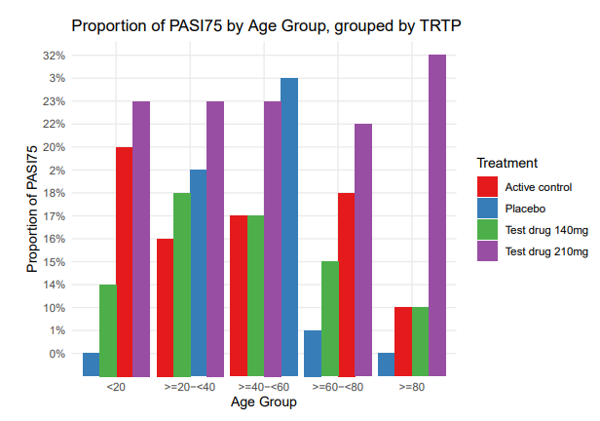
Age vs. PASI>=75
 |  | Placebo | Active control | Test drug 140mg | Test drug 210mg
Age(in years)
 | Minimum | 8 | 5 | 10 | 3
 | Maximum | 84 | 88 | 82 | 83
 | Mean | 45.6 | 45.3 | 45.4 | 45.1
 | Median | 45 | 45 | 45 | 45
Subjects by Age group
 | <20 | 35 | 30 | 90 | 100
 | >=20-<40 | 460 | 475 | 890 | 860
 | >=40-<60 | 850 | 815 | 1640 | 1715
 | >=60-<80 | 190 | 170 | 420 | 360
 | >=80 | 10 | 10 | 10 | 25
Similar age distribution for each treatment group.
Test drug 210 mg has the best results followed by test drug 140 mg.
Age groups “>=20-<40” and “>=40 - <60” have highest number of positive outcomes, but also have the higher number of patients as compared to the other age groups.
Age does not influence treatment outcome.

Slide 10
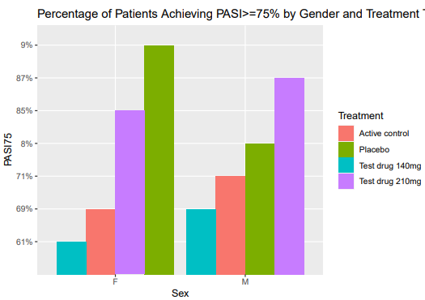
Gender vs. PASI >=75
 | Placebo | Active control | Test drug 140mg | Test drug 210mg
Male | 197 | 207 | 409 | 434
 | (64%) | (69%) | (67%) | (71%)
Female | 112 | 93 | 201 | 178
 | (36%) | (31%) | (33%) | (29%)
No indication that gender has any definitive impact on treatment outcomes.

Slide 11
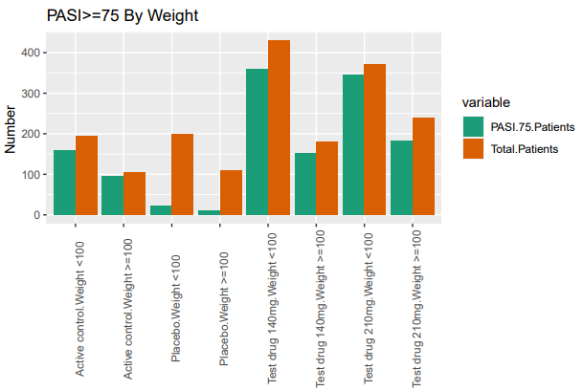
Weight vs. PASI >=75
 |  | Placebo | Active control | Test drug 140mg | Test drug 210mg
Weight(in kgs)
 | Minimum | 20.6 | 32.1 | 30.1 | 23.7
 | Maximum | 145.7 | 154.2 | 154.1 | 166.5
 | Mean | 91.2 | 92.4 | 91.1 | 91.6
 | Median | 91.8 | 91.5 | 91.9 | 91.4
Subjects by Weight
Weight <100 kgs |  | 200 | 194 | 430 | 372
 |  | (65%) | (65%) | (70%) | (61%)
Weight >=100 kgs |  | 109 | 106 | 180 | 240
 |  | (35%) | (35%) | (30%) | (39%)
Rate of Success
Weight <100 kgs |  | 11% | 82% | 83% | 93%
Weight >=100 kgs |  | 10% | 90% | 84% | 76%
Test drug 210 mg is the most effective treatment plan for patients weighing < 100 kgs.
Test drug 140 mg has a uniform rate of success irrespective of weight.

Slide 12
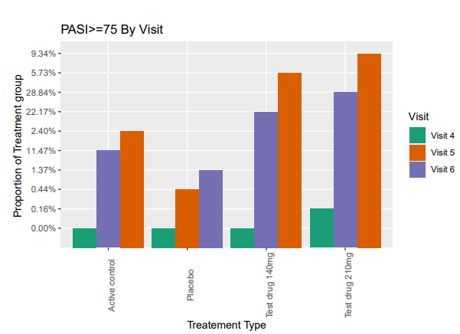
Visit vs. PASI>=75, Classified by Doses
 | VISIT 4 | VISIT 5 | VISIT 6
Total patients | 1831 | 1831 | 1831
PASI >=75% | 3 | 328 | 1169
Percentage achieving PASI >=75% | 0% | 18% | 64%
Test drug 210 mg shows marked improvement of PASI scores from Visit 3 and by Visit 6 , it proves to be the best available treatment, over Test drug 140 mg and Active control.
Whether Test drug 140 mg is superior in comparison with Active Control is not very clear, treatment effects appear quite close.

Slide 13
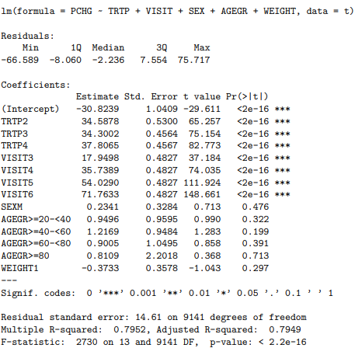
A basic regression model
Objective:
To identify whether “PCHG” i.e. percent change in PASI score (continuous variable) can be explained by categorical variables “SEX”,”AGE GROUP”,”WEIGHT”, “VISIT.No.” or “TREATMENT” type.
Linear Model : PCHG ~ TREATMENT + SEX + AGE +VISIT
Treatment type and Visit. No.are the statistically significant drivers of Percentage change in PASI scores.
Age, Sex or Weight have no impact on treatment efficacy.

Slide 14
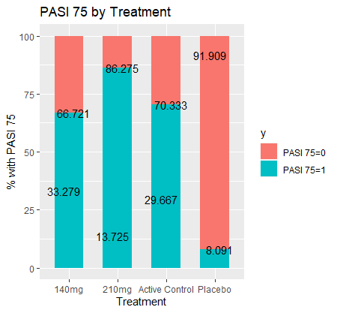
PASI 75 Proportion by Treatment

Slide 15
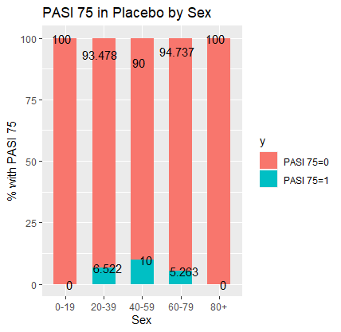
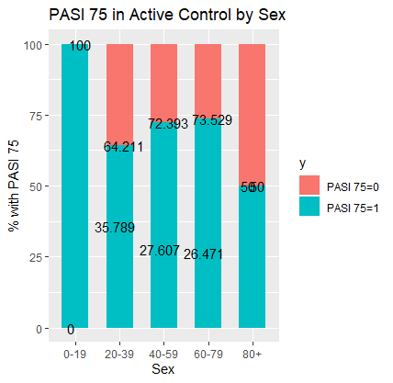
PASI 75 Proportion by Sex for Placebo and Active Control

Slide 16
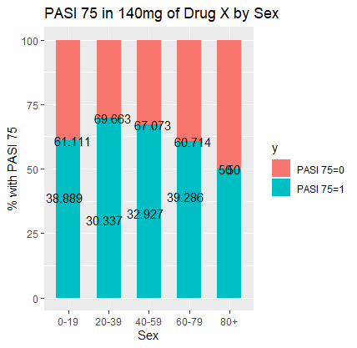
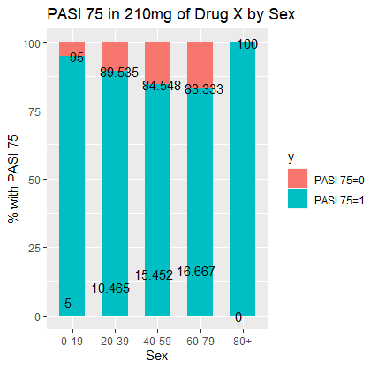
PASI 75 Proportion by Sex for 140mg and 210mg Doses

Slide 17


PASI 75 Proportion by Age for Placebo and Active Control

Slide 18
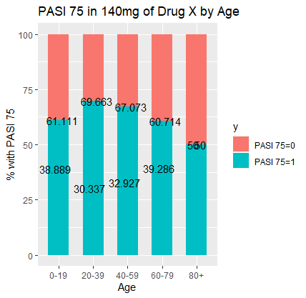
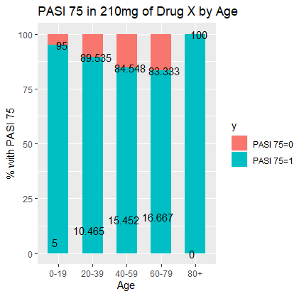
PASI 75 Proportion by Age for 140mg and 210mg Doses

Slide 19
Primary Analysis
Notes:
For the primary analysis, there were two families of hypotheses that were tested.

Slide 20
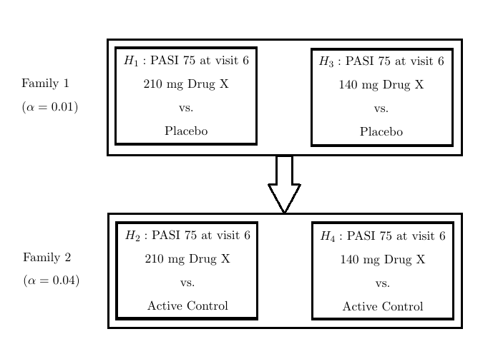
Hypotheses - PASI 75 at Visit 6
Notes:
In Family 1, we are looking at PASI 75 at visit 6 for 210mg of the test drug against the placebo and 140mg of the test drug against the placebo. For Family 2, we are testing PASI 75 at visit 6 for 210mg of the drug against the active control and also 140mg of the drug against the active control.

Slide 21
Cochran Mantel-Haenszel (CMH) Test
Notes:
The first method in the primary analysis is the CMH Test.

Slide 22
Classes
1: Weight <= 100kg and Base PASI Score <= Median(Base PASI Score)
2: Weight > 100kg and Base PASI Score <= Median(Base PASI Score)
3: Weight <= 100kg and Base PASI Score > Median(Base PASI Score)
4: Weight > 100kg and Base PASI Score > Median(Base PASI Score)
Notes:
We created classes to create the strata. Class 1 is a weight less than or equal to 100 kilograms and a baseline PASI score less than or equal to the median of baseline PASI scores. Class 2 is the same, but with a weight greater than 100. Class 3 is a weight less than or equal to 100 kilograms and baseline PASI greater than the median. Class 4 is a weight greater than 100 and baseline PASI greater than the median.

Slide 23
Split Recycle Method (⍺ = 0.05)
Placebo
⍺₁ = 0.01
⍺_{i} = 0.005, 0.0075
Active Control
⍺₂ = 0.04
⍺_{i} = 0.02, 0.03
Notes:
The split recycle alpha method was used, along with parallel gatekeeping. Starting with an alpha level of 0.05, the placebo group gets 0.01 and active control group gets 0.04.

Slide 24
Family 1
H1: 210mg v Placebo
⍺ = 0.005
MH statistic = 516.56
p-value < 2.2e-16
cOR = 70.24644
Reject H1
H3: 140mg v Placebo
⍺ = 0.0075
MH = 280.82
p-value < 2.2e-16
cOR = 22.94063
Reject H3
Notes:
Performing the CMH test for Family 1, we get the p-values 0.1801 for 210mg and 0.3496 for 140mg. Testing H3 first, we accept H3 and then we also accept H1. The odds of not achieving PASI 75 on the placebo is 0.82 times the odds of not achieving PASI 75 on the 210mg dose.

Slide 25
Reject H1 and H3
P₃ > P₁
The association between treatment and PASI 75 is significant
Treatment and PASI 75 are not independent of each other
Now, we test H2 and H4 from Family 2
Notes:
The overall association between treatment and PASI 75 is not significant is not significant across the classes. Or the common odds ratio is not significantly different from 1.

Slide 26
Family 2
H2: 210mg v Active Control
⍺ = 0.02
MH statistics = 33.372
p-value = 7.61e-09
cOR = 2.692409
H4: 140mg v Active Control
⍺ = 0.03
MH = 1.0393
p-value = 0.308
cOR = 0.8467842
Notes:
These are the values we get from running the CMH test on Family 2, which are not used in this case.

Slide 27
Accept H4 and Reject H2
There is no association between treatment and PASI 75 when comparing 140 mg of the drug and the active control
But there is an association between treatment and PASI 75 for 210 mg of the test drug compared to the active control

Slide 28
Logistic Regression
Notes:
The second part of the primary analysis was logistic regression.

Slide 29
Covariates
PASI 75:
1 = Achieved 75% reduction in PASI score from baseline
0 = Did not achieve 75% reduction in PASI score from baseline
Treatment:
1 = 210mg Test Drug or 140mg Test Drug
0 = Placebo or Active Control,
Baseline Body Weight Group:
1 = Weight > 100kg
0 = Weight <= 100kg
Baseline PASI Score by Median Group:
1 = Base PASI > Median
0 = Base PASI <= Median
Notes:
The response variable was PASI 75, so whether the subject achieved 75% reduction in the PASI score from baseline or not. The other covariates are treatment, baseline body weight group, and baseline PASI score by Median group.

Slide 30
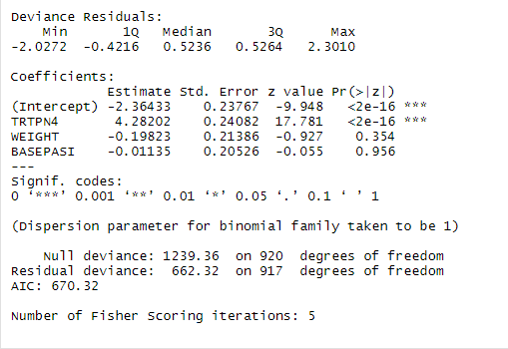
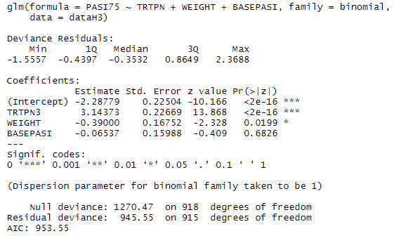
Family 1
H1: 210mg v Placebo
H3: 140mg v Placebo
Notes:
After running the regression, the p-values are <2e-16 for both hypotheses. We reject both null hypotheses.

Slide 31
Reject H1 and H3
PASI 75 for 210mg is significantly different than PASI 75 for placebo
PASI 75 for 140mg is significantly different than PASI 75 for placebo
Better improvement in PASI for subjects who took the test drug
Notes:
PASI 75 for 210mg is significantly different than for the placebo. Which is also the same for 140mg of the dose. So, there is better improvement in PASI for subjects who took the test drug. Next, we test Family 2.

Slide 32
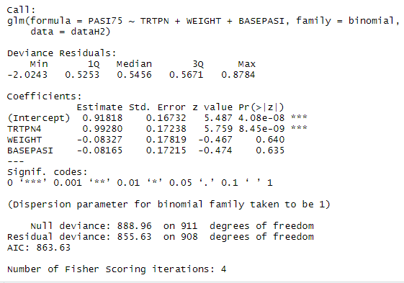
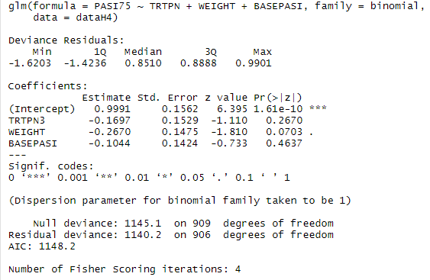
Family 2
H2: 210mg v Active Control
H4: 140mg v Active Control
Notes:
The p-values here are 8.45e-9 and 0.2670. Starting with H4, we accept H4 and then we reject H2.

Slide 33
Accept H4 and Reject H2
There is no difference in PASI 75 for the 140mg dose compared to the active control
There is a significant difference in PASI 75 for the 210mg dose of the test drug compared to the active control
Notes:
There is no significant difference in PASI 75 for the 140mg dose compared to the active control, but there is a significant difference between the 210mg dose of the test drug and the active control.

Slide 34



Slide 35

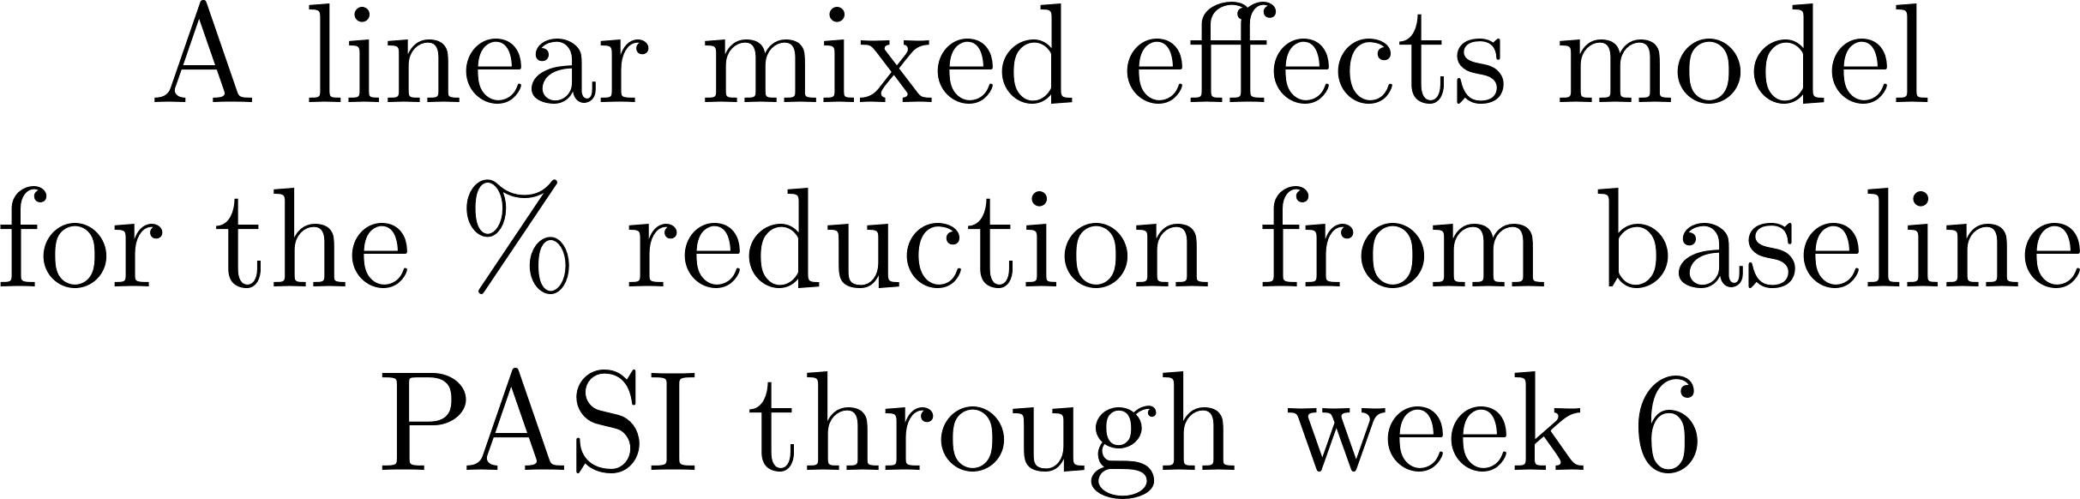

Slide 36

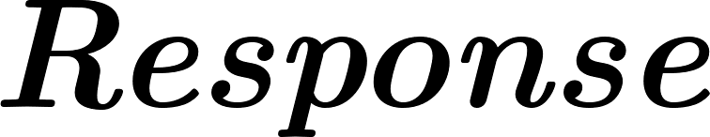

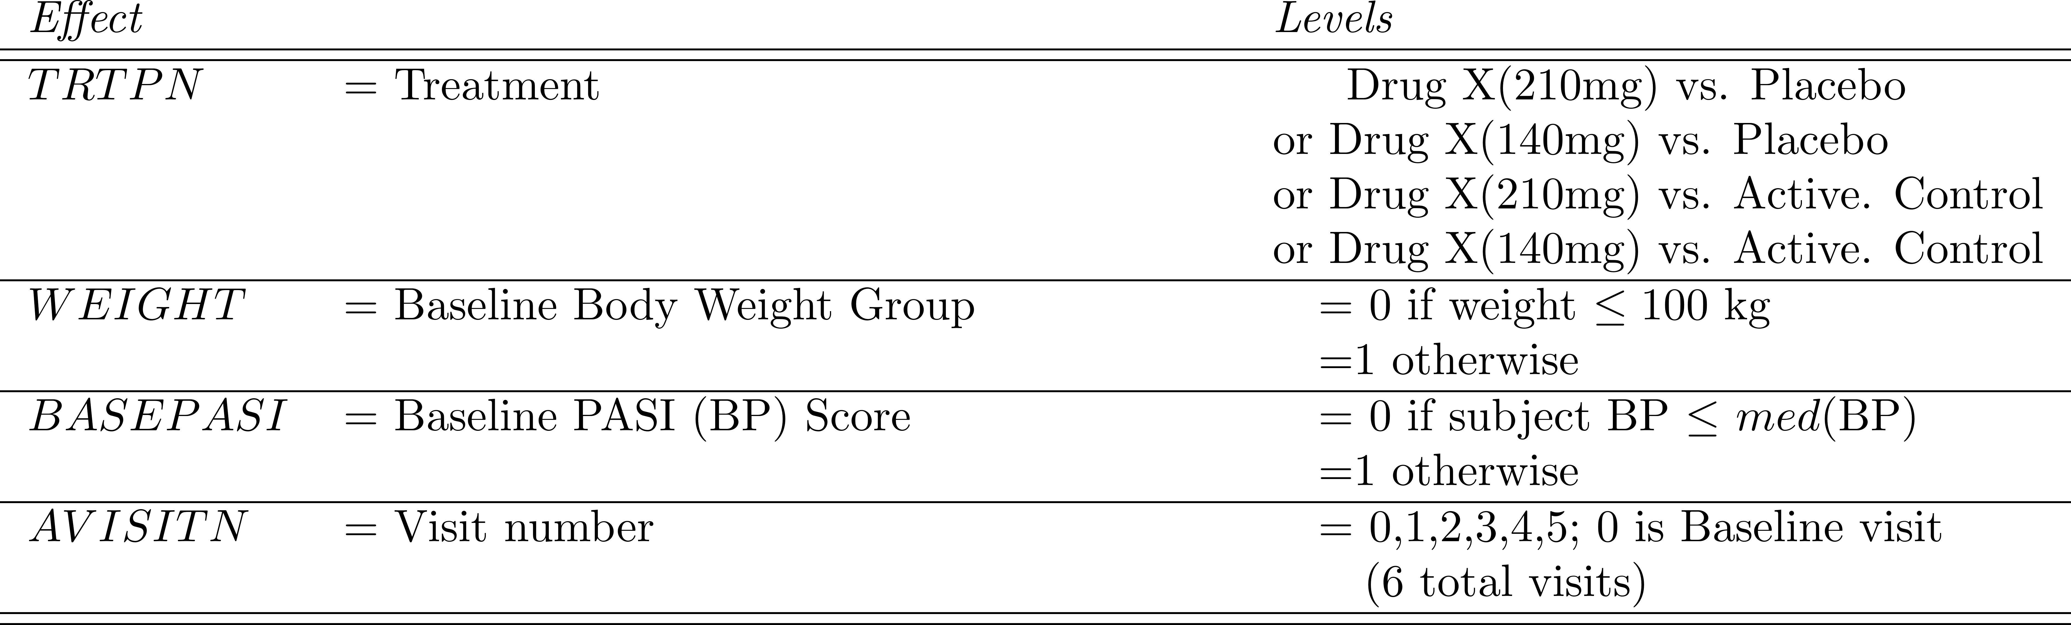

Accept H4 and Reject H2

Slide 37
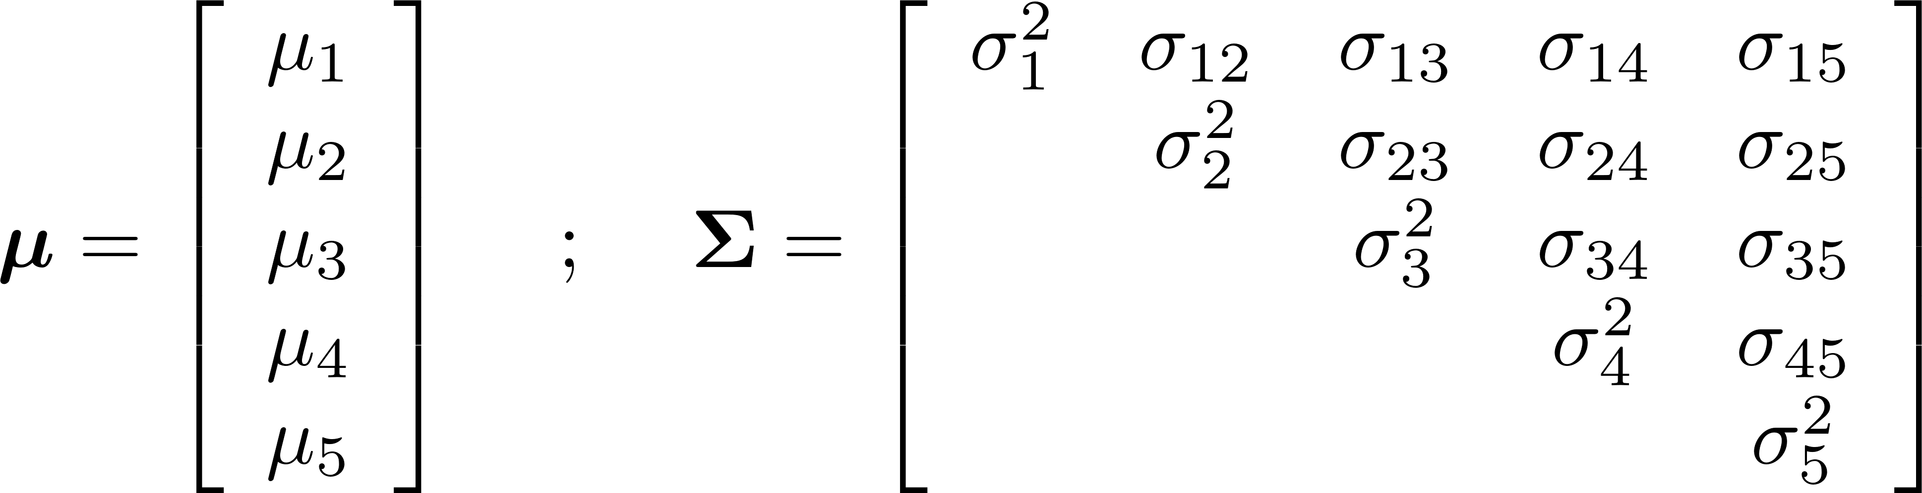

Slide 38

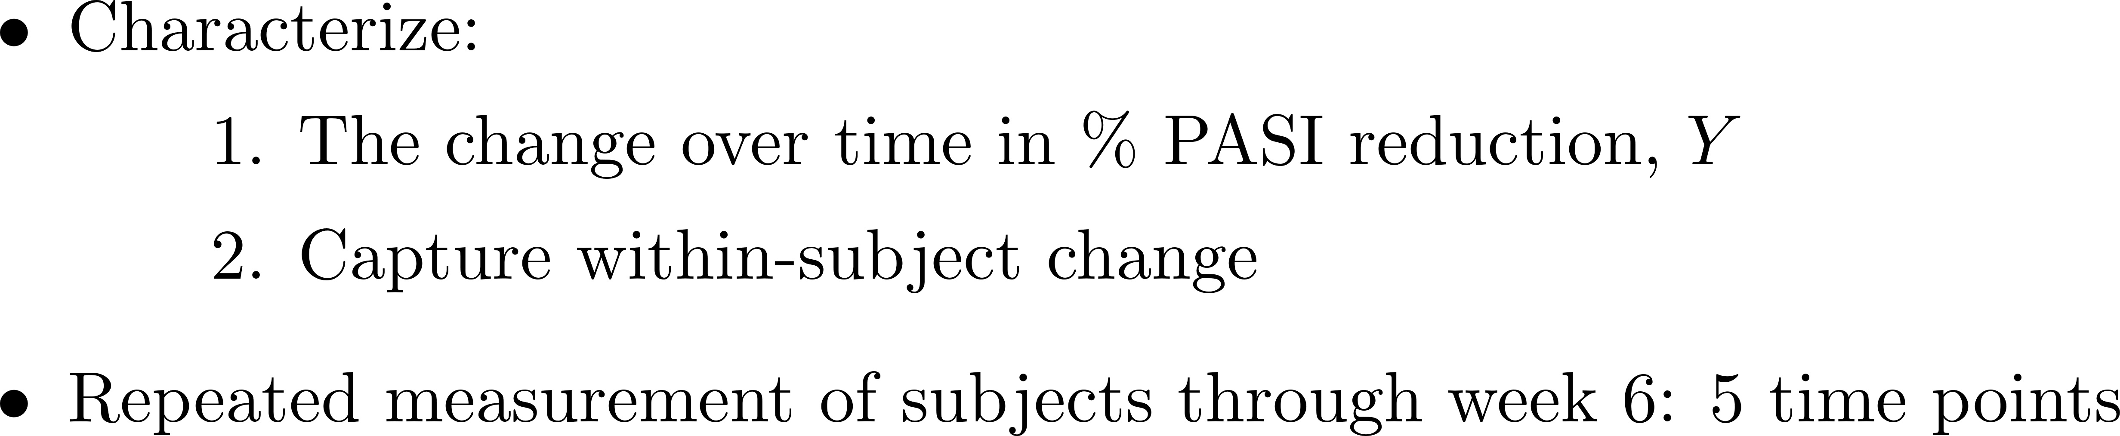
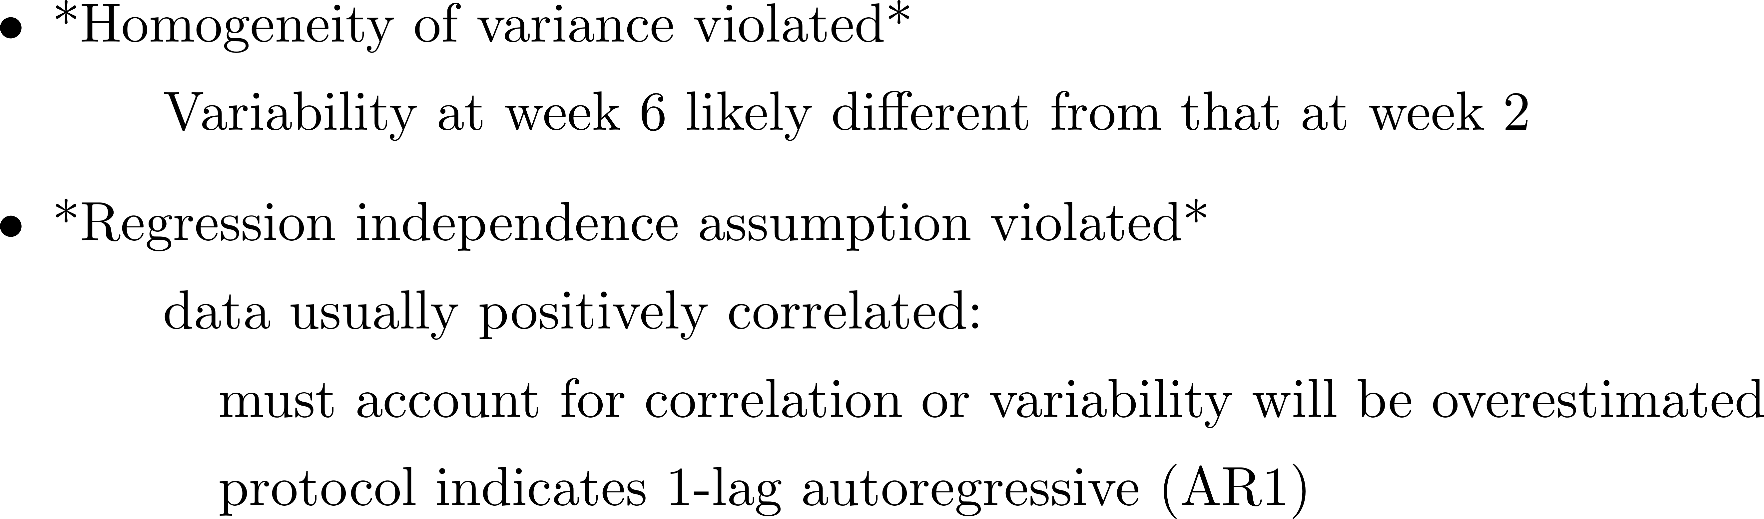

Slide 39
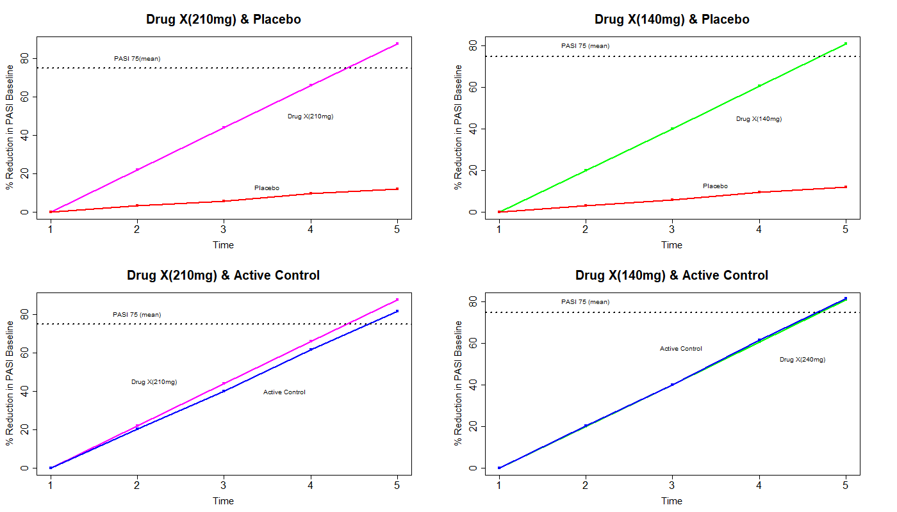

Slide 40



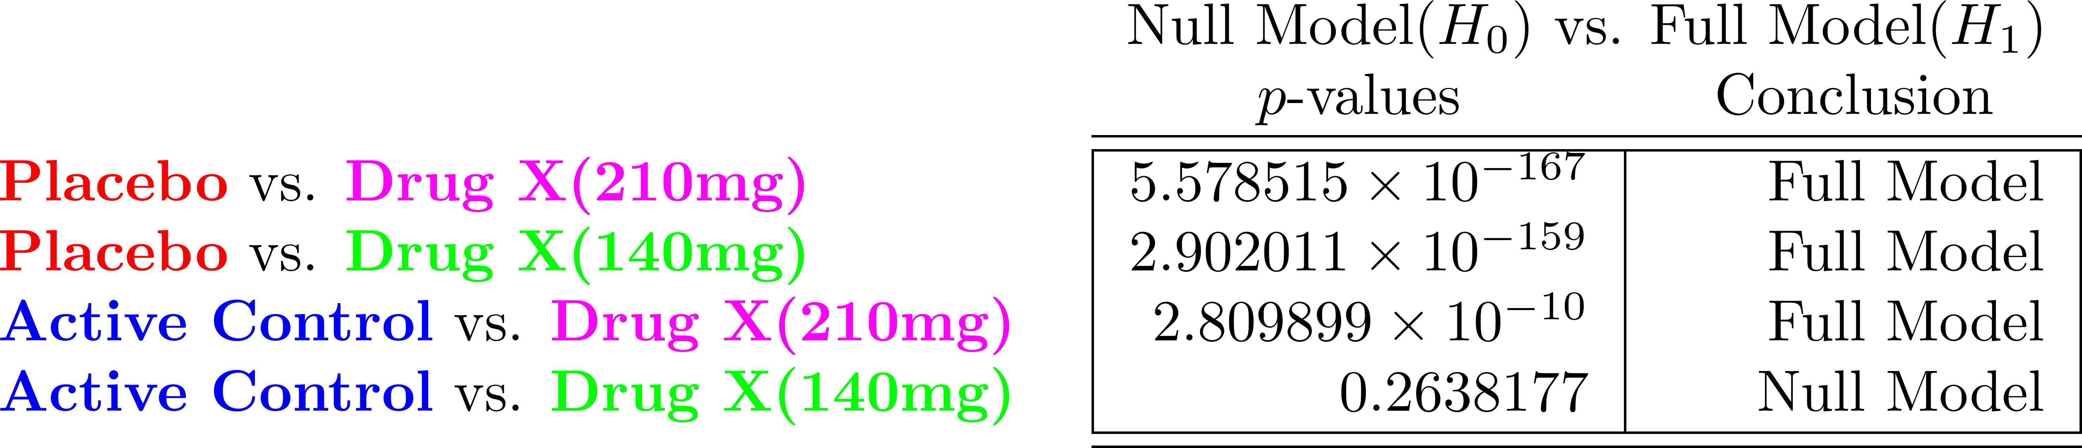

Slide 41

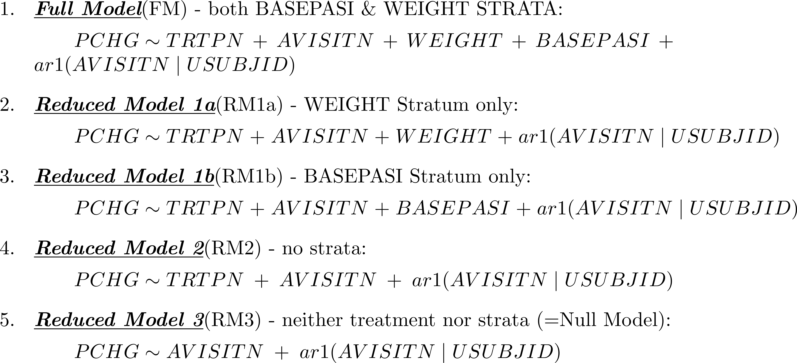

Slide 42
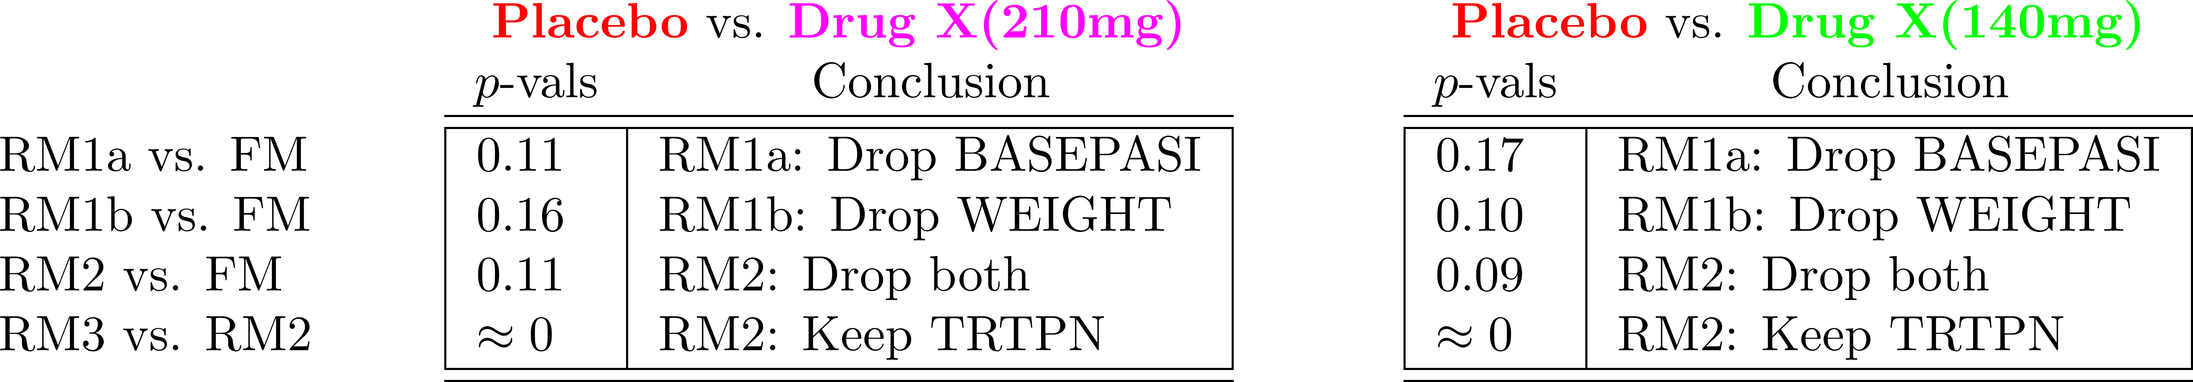
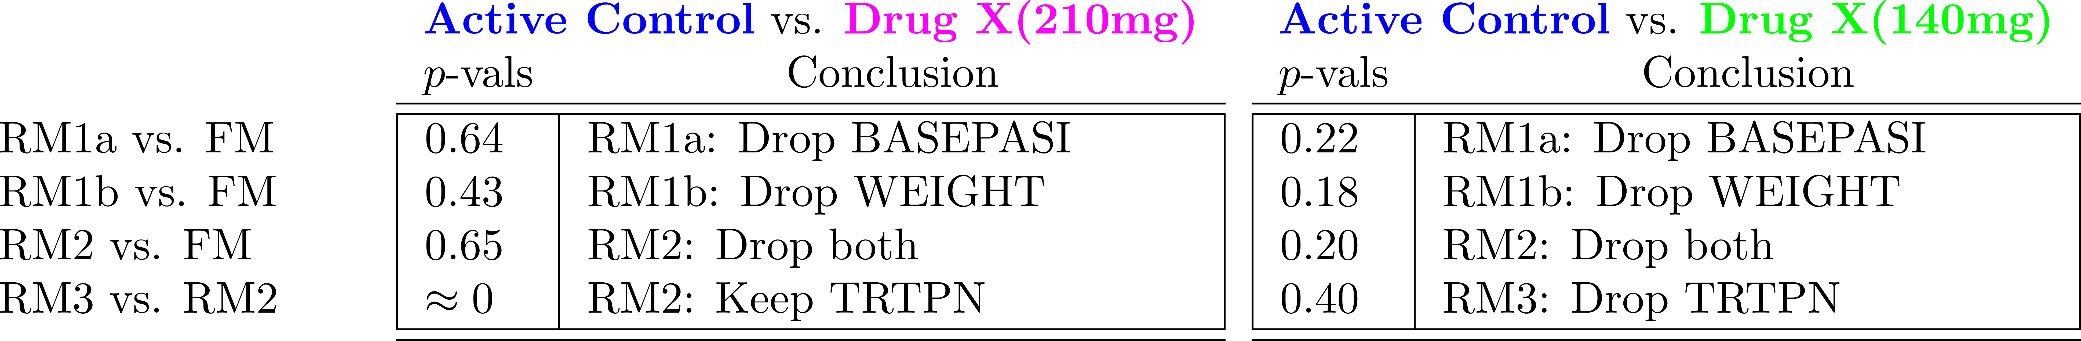

Slide 43

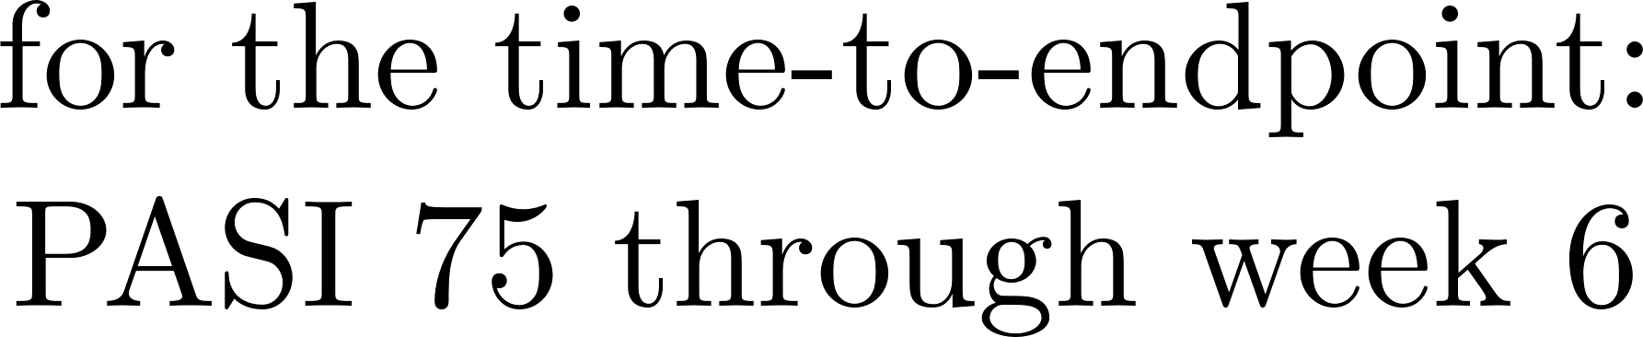

Slide 44
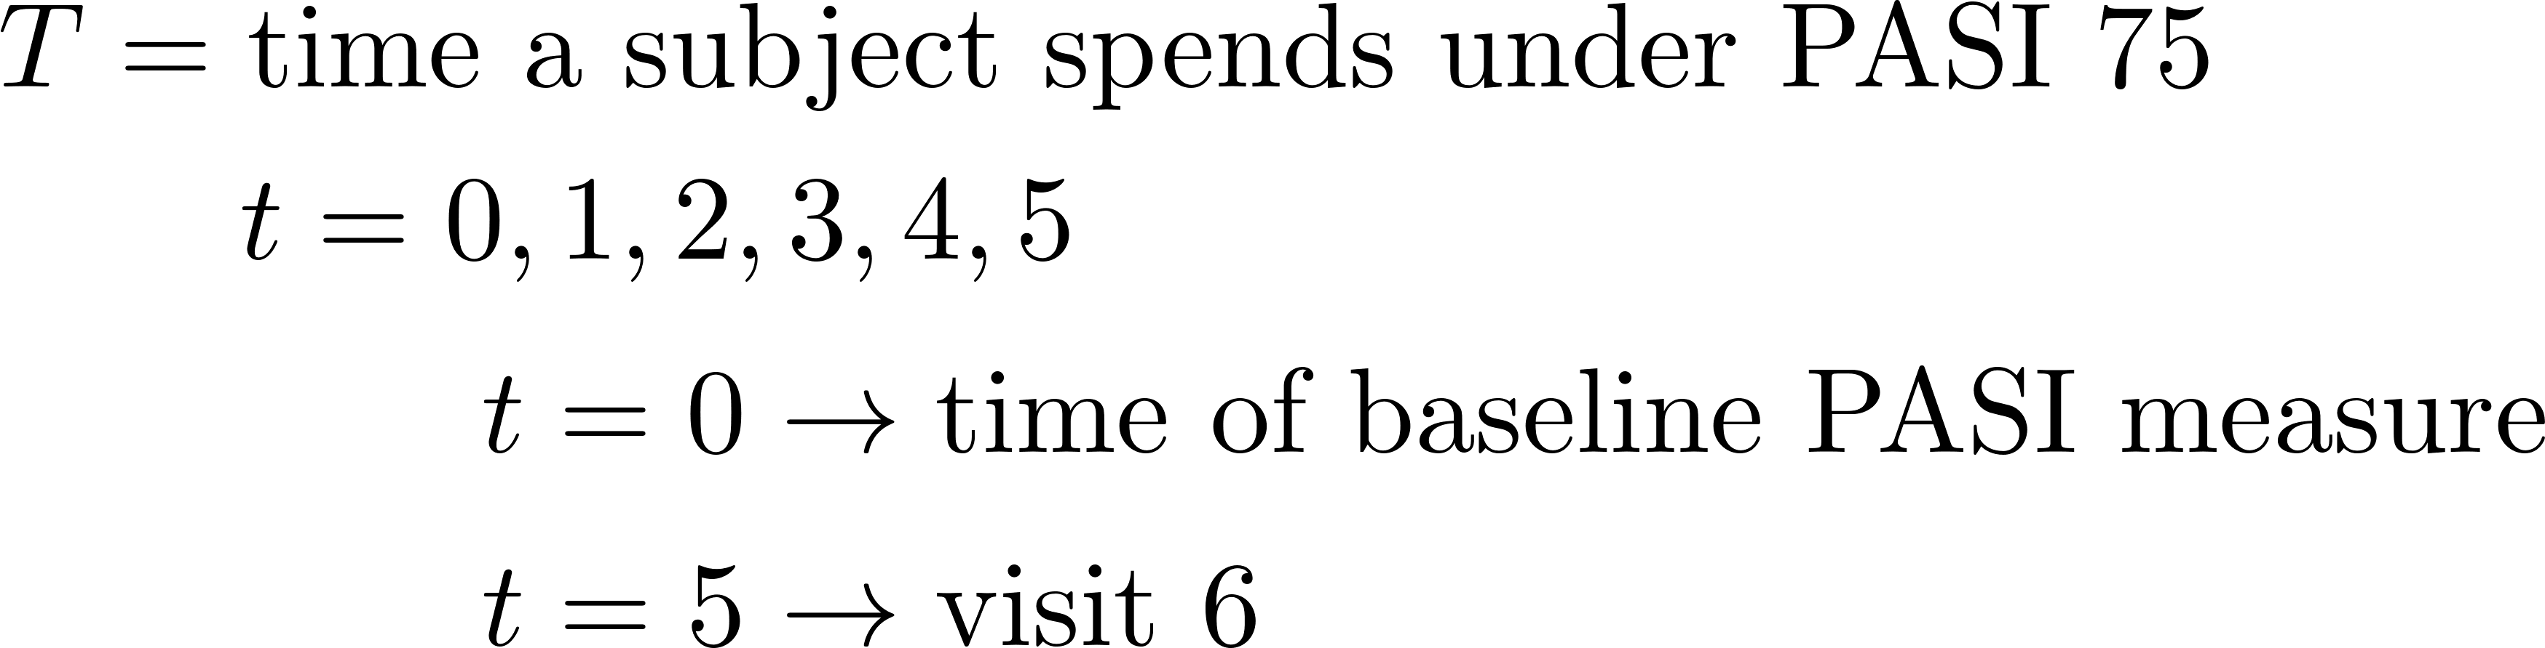
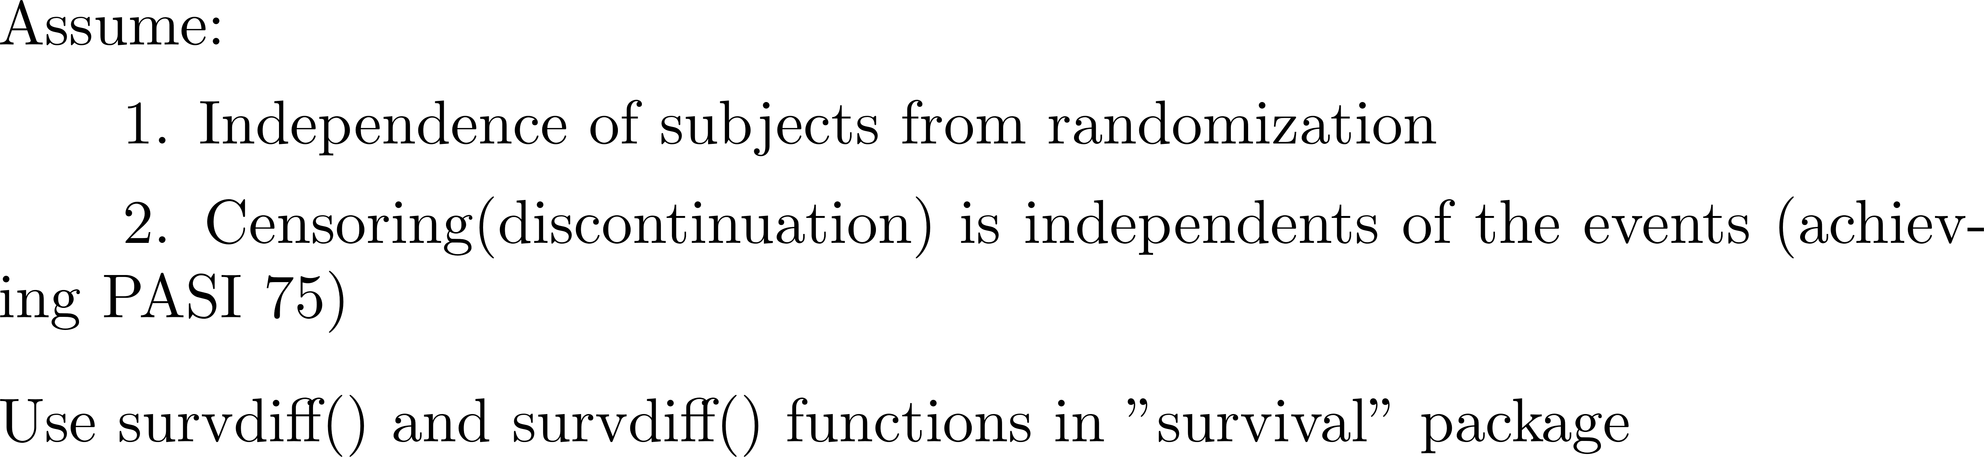

Slide 45

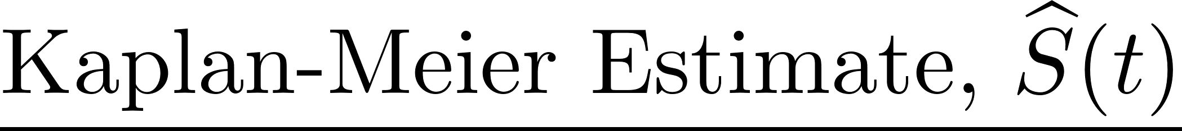
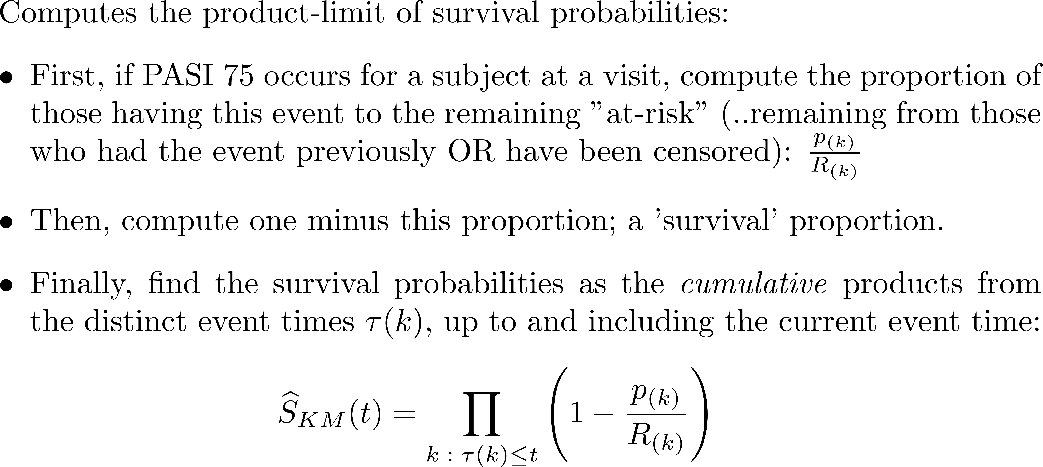

Slide 46


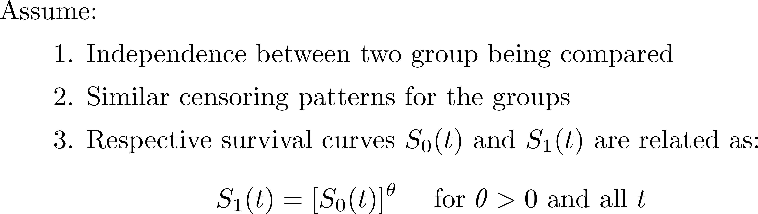
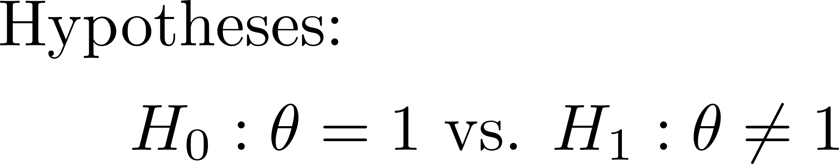

Slide 47
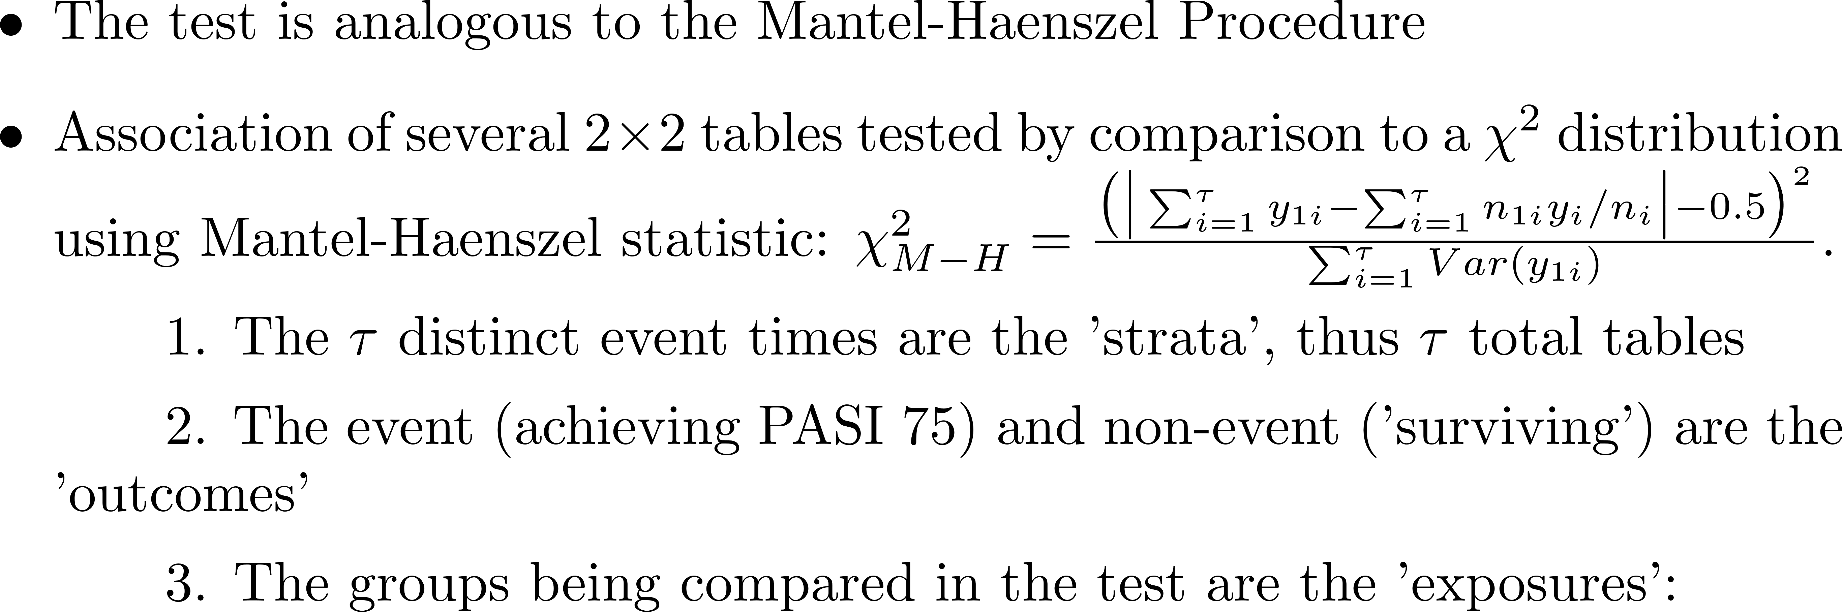
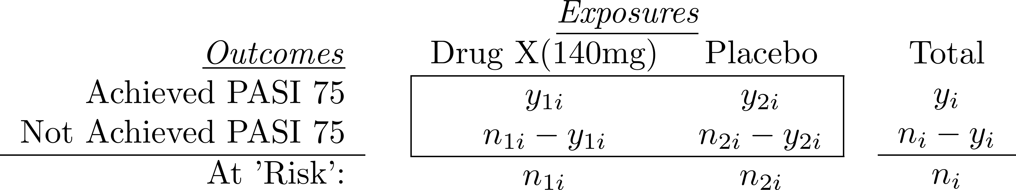

Slide 48
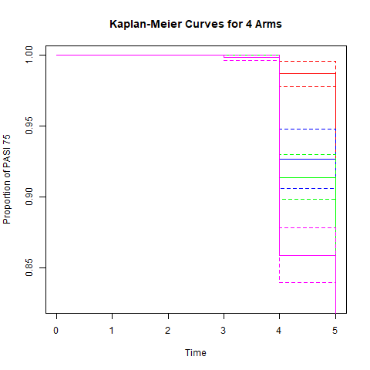
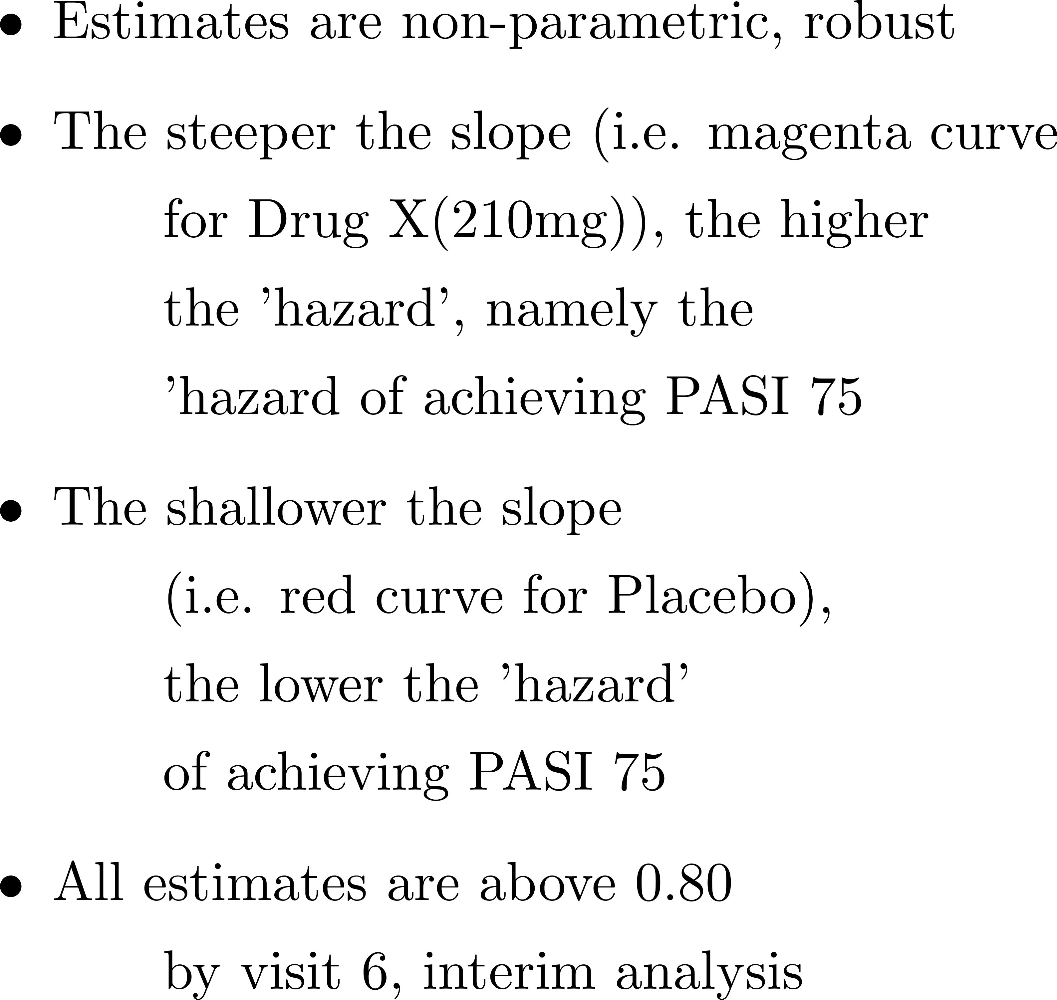
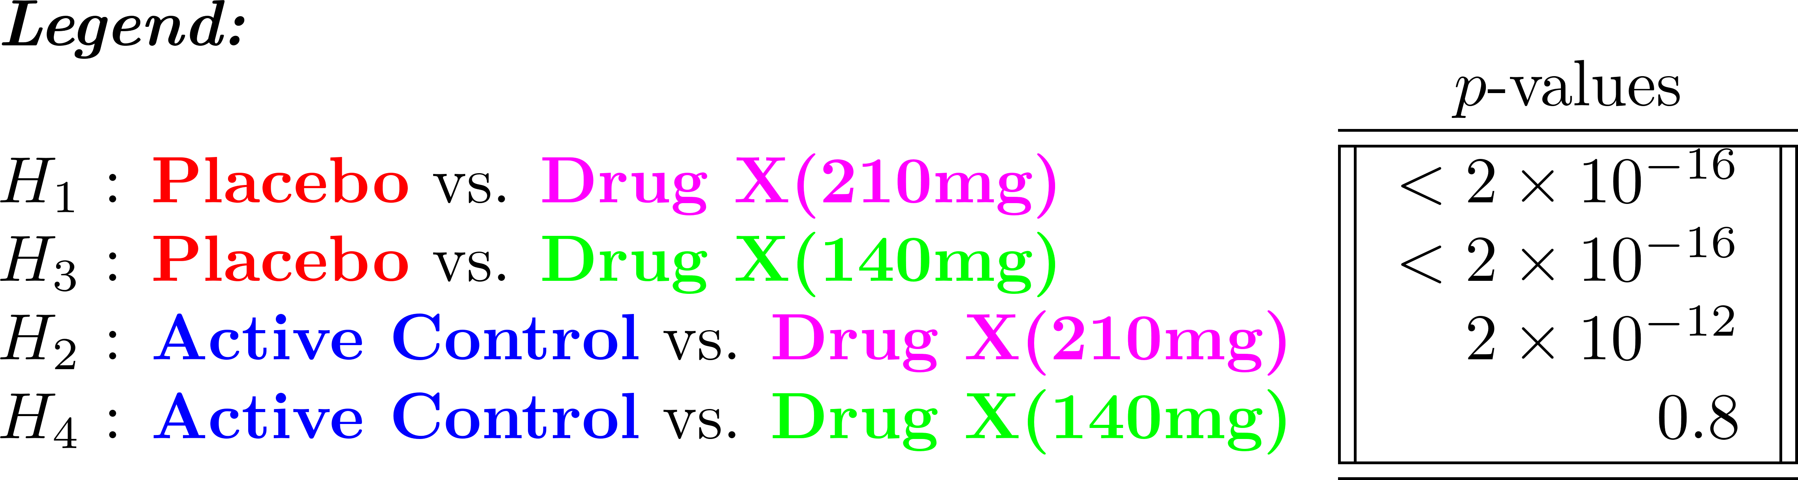

Slide 49






Slide 50






Slide 51


Slide 52






Slide 53



Slide 54




Slide 55


Slide 56


